Slide 1





Time Series Analysis
Time Series
Analysis
Today’s Topic: ACF and PACF
Dr. Si Thu Aung
in/drsithuaung/
https://sithuaung-ink.github.io/data-analyst-portfolio/
Notes:
Today, we’re talking about time series stationarity.
So, What is stationarity?

Slide 2
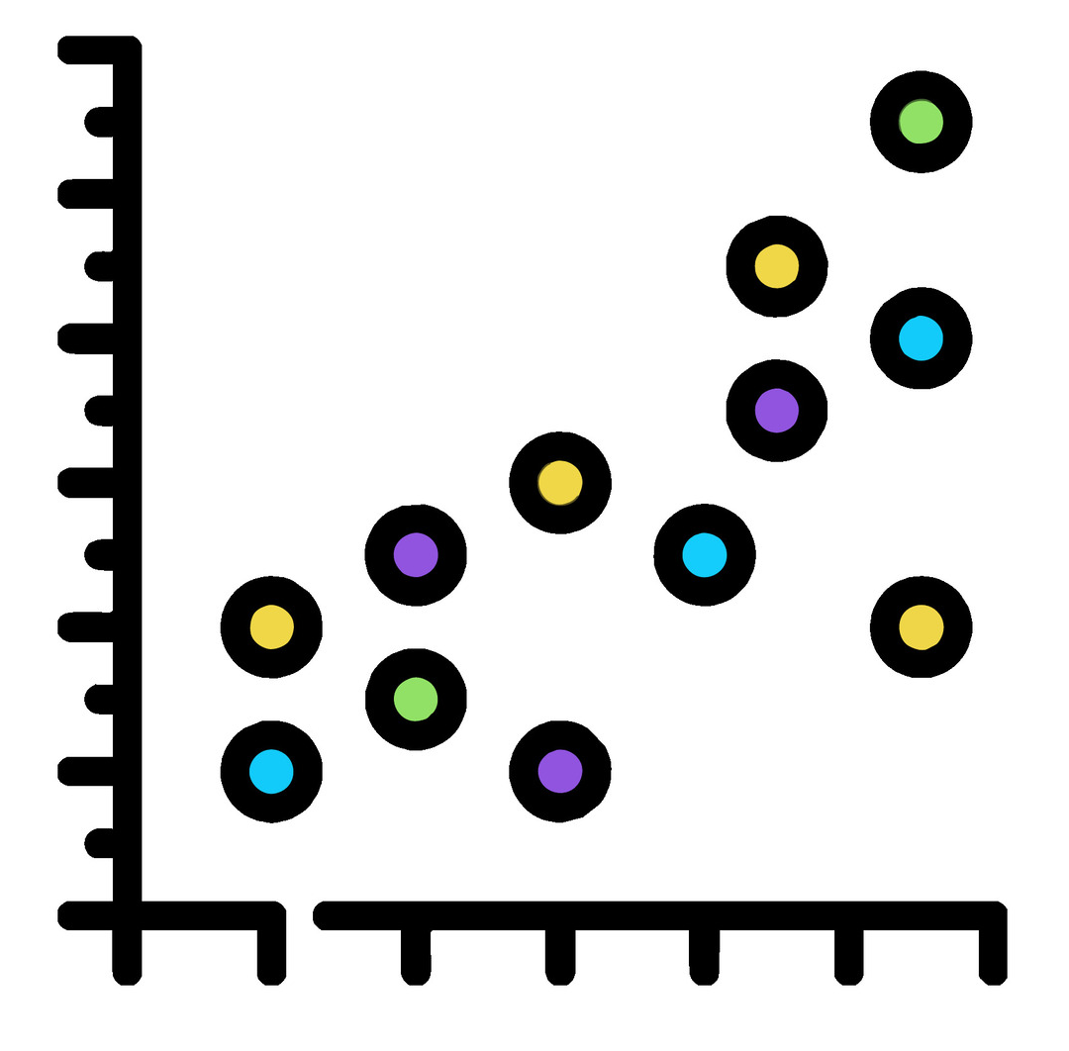
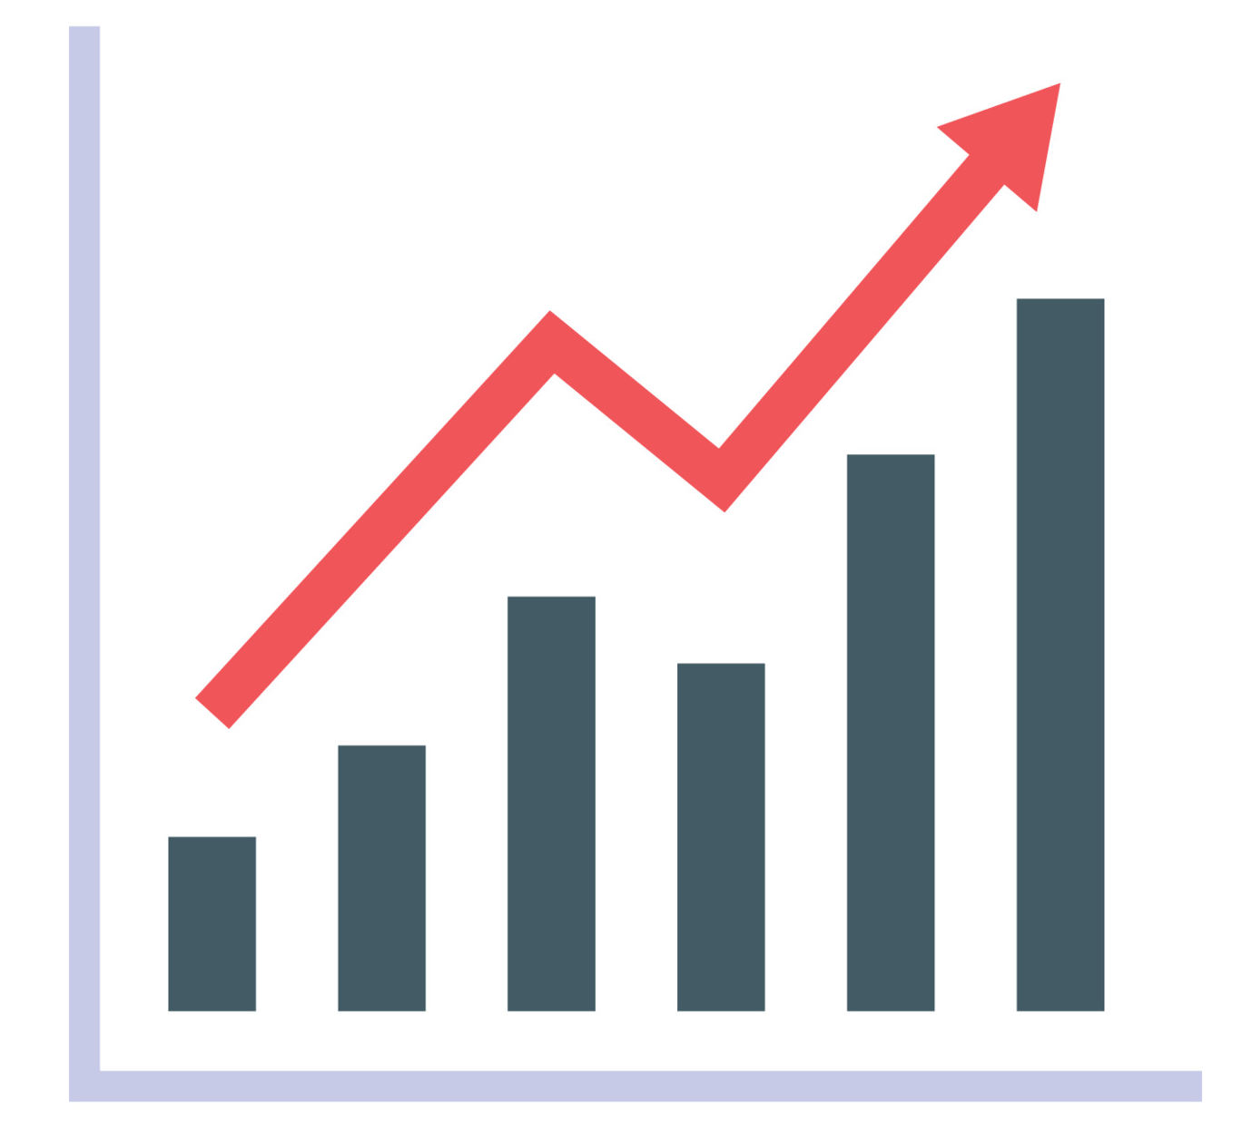
Content
Person Correlation Coefficient
Autocorrelation Function
Partial Autocorrelation Function

Slide 3
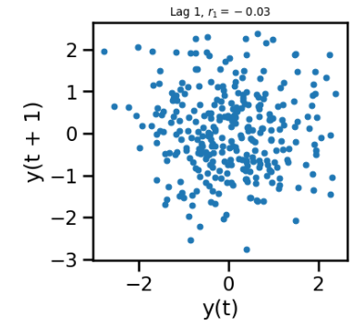
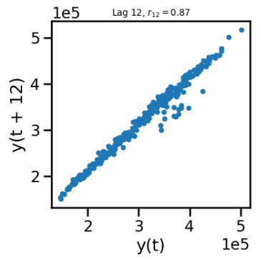
Lag plot limitations
Lag plots are a visual tool that can help identify useful lags.
If we quantify when y_{t-k} is highly correlated with y_{t}, then it would be easier to identify useful lags.
Autocorrelation is a method to quantify the correlation of a time series with itself.

Slide 4
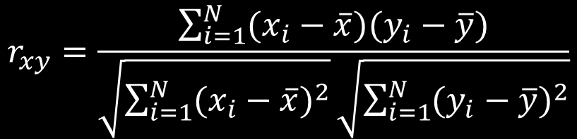
Pearson Correlation Coefficient
Measure the strength of the linear relationship between two variables.
Mean
X | Y
23 | 26
30 | 31
35 | 32
30 | 29
$$r_{xy}=\frac{\sum_{i=1}^{N}{(x_{i}−\overline{x})(y_{i}−\overline{y})}}{\sqrt{\sum_{i=1}^{N}{{(x_{i}−\overline{x})}^{2}}}\sqrt{\sum_{i=1}^{N}{{(y_{i}−\overline{y})}^{2}}}}$$

Slide 5
Pearson Correlation Coefficient
Measure the strength of the linear relationship between two variables.
Covariance
r = 0 : No correlation
r > 0: Positive linear correlation
r < 0: Negative linear correlation
-1 ≤ r ≤ 1
$$r_{xy}=\frac{\sum_{i=1}^{N}{(x_{i}−\overline{x})(y_{i}−\overline{y})}}{\sqrt{\sum_{i=1}^{N}{{(x_{i}−\overline{x})}^{2}}}\sqrt{\sum_{i=1}^{N}{{(y_{i}−\overline{y})}^{2}}}}$$
Standard deviation

Slide 6

Pearson Correlation Coefficient
Measure the strength of the linear relationship between two variables.
Covariance
r = 0 : No correlation
r > 0: Positive linear correlation
r < 0: Negative linear correlation
-1 ≤ r ≤ 1
$$r_{xy}=\frac{cov(x,y}{σ_{x}σ_{xy}}$$
Standard deviation

Slide 7
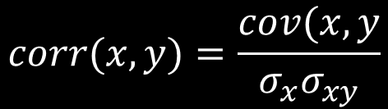
Pearson Correlation Coefficient
Measure the strength of the linear relationship between two variables.
Covariance
r = 0 : No correlation
r > 0: Positive linear correlation
r < 0: Negative linear correlation
-1 ≤ r ≤ 1
$$corr(x,y)=\frac{cov(x,y}{σ_{x}σ_{xy}}$$
Standard deviation

Slide 8
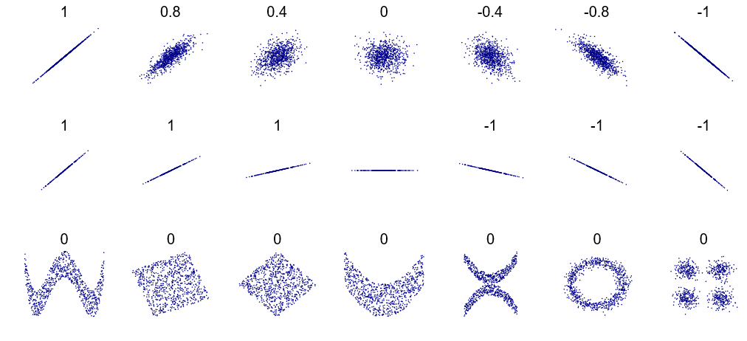
Pearson Correlation Coefficient

Slide 9
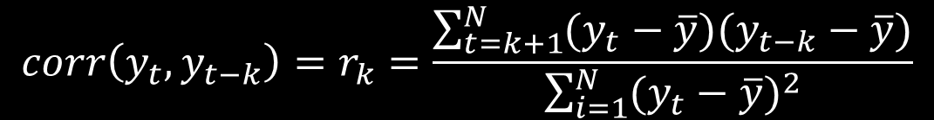
Autocorrelation Function (ACF)
The ACF is correlation of a time series y_{t} with a lagged version of itself y_{t-k}.
Y | Y (Lag 2 )
23 | NaN
30 | NaN
35 | 23
30 | 30
$$corr\left(y_{t},y_{t−k}\right)=r_{k}=\frac{\sum_{t=k+1}^{N}{(y_{t}−\overline{y})(y_{t−k}−\overline{y})}}{\sum_{i=1}^{N}{{(y_{t}−\overline{y})}^{2}}}$$
If the autocorrelation at lag k is larger, it might be useful in forecasting.

Slide 10
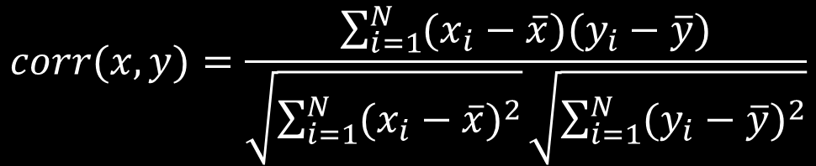
Autocorrelation Function (ACF)
The ACF is correlation of a time series y_{t} with a lagged version of itself y_{t-k}.
Y | Y (Lag 2 )
23 | NaN
30 | NaN
35 | 23
30 | 30
$$corr(x,y)=\frac{\sum_{i=1}^{N}{(x_{i}−\overline{x})(y_{i}−\overline{y})}}{\sqrt{\sum_{i=1}^{N}{{(x_{i}−\overline{x})}^{2}}}\sqrt{\sum_{i=1}^{N}{{(y_{i}−\overline{y})}^{2}}}}$$

Slide 11
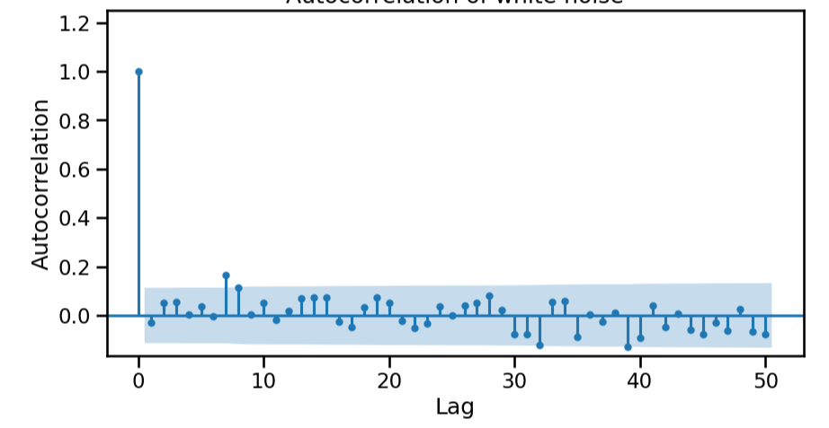
Autocorrelogram
If the autocorrelation (r_{k}) is outside this blue interval (95% confidence interval from Bartlett’s formula), we can conclude that r_{k} is significant.

Slide 12
Autocorrelation Function (ACF)
Summary
The Autocorrelation Function (ACF) measures the correlation of a time series with its own past values at different time lags.
The confidence interval of the ACF at a given lag can be given by the Bartlett formula, which helps determine if the autocorrelation is significant.

Slide 13
Partial Autocorrelation Function (PACF)
We want to know which lags y_{t-k} are most predictive of y_{t}.
y_{t-2} will influence y_{t-1} which influences y_{t}
This means that the autocorrelation between y_{t} and y_{t-2} will be non-zero even though only a lag of 1 matters.
y_{t-2}
y_{t-2}
y_{t-2}

Slide 14
Partial Autocorrelation Function (PACF)
The partial autocorrelation function (PACF) measures the correlation between y_{t} and y_{t-k} after removing the correlation introduced by intermediate lags on y_{t} and y_{t-k}.
The PACF at lag 1 is the correlation between y_{t} and y_{t-1}.
The PACF at lag 2 is the correlation between y_{t} and y_{t-2} after removing the effects of y_{t-1}.
The PACF at lag 3 is the correlation between y_{t} and y_{t-3} after removing the effects of y_{t-1} and y_{t-2}.
We will use the software packages for the calculation of the PACF.
0
1
2
3
y_{t}
y_{t-1}
y_{t-2}
y_{t-3}

Slide 15
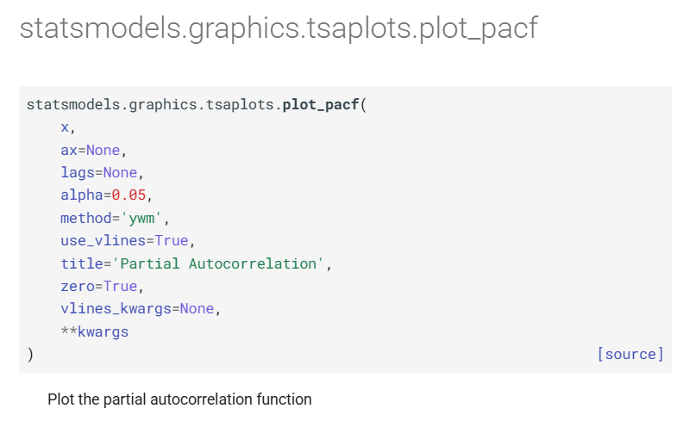
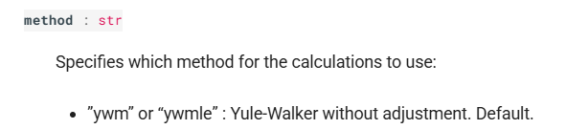
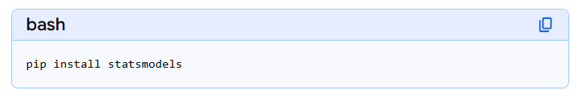
Partial Autocorrelation Function (PACF)
Summary
The Partial Autocorrelation Function (PACF) measures how correlated y_{t} is with itself at lag y_{t-k} after removing the effect of intermediate lags.

